Slide 1
Mobile and Cloud
Module 3

Slide 2

CLIENT SERVER ARCHITECTURE
Advantanges
Send processing back to server
Thin clients
Reuse APIs
Distribution of load
Disadvantages
Backend Updates are tricky
Maintaining consistency across platforms

Slide 3
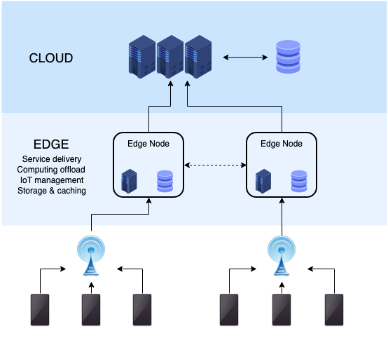
CLOUD to EDGE computing
Moving service delivery closer to end nodes
Bandwidth issues are being solved
Popular for IoT solutions
Caching of frequently used data

Slide 4
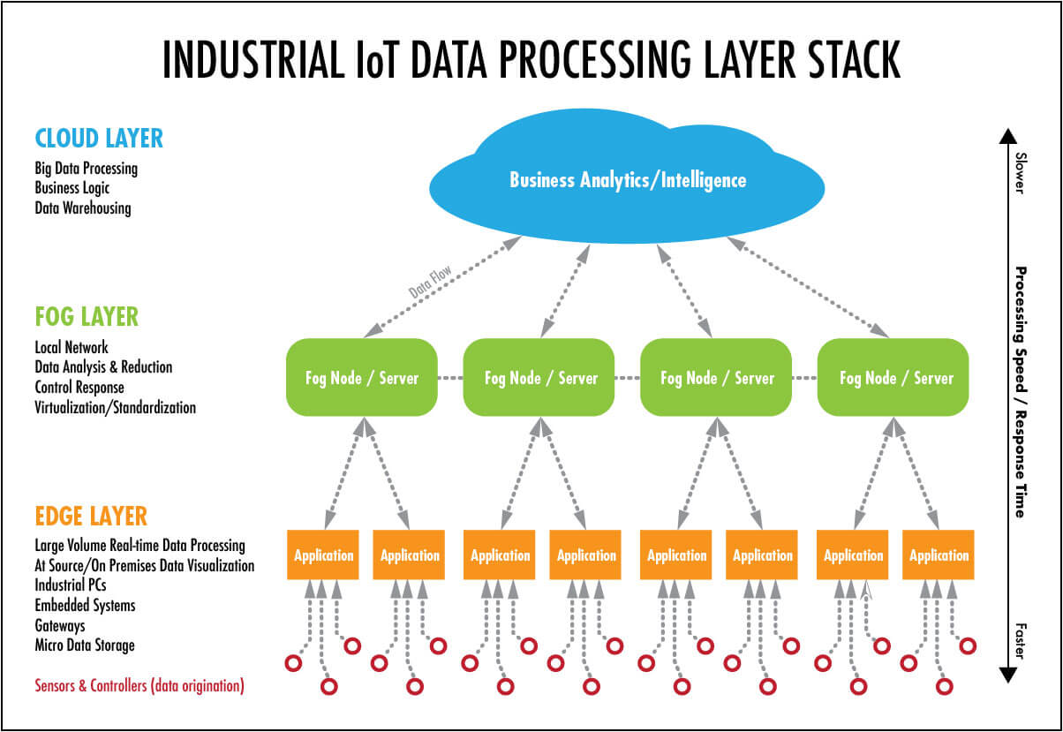
CLOUD to Fog to EDGE computing
Three layer cloud model
Edge contains final visualization and device handling only
Fog layer is distributed processing of edge devices.

Slide 5
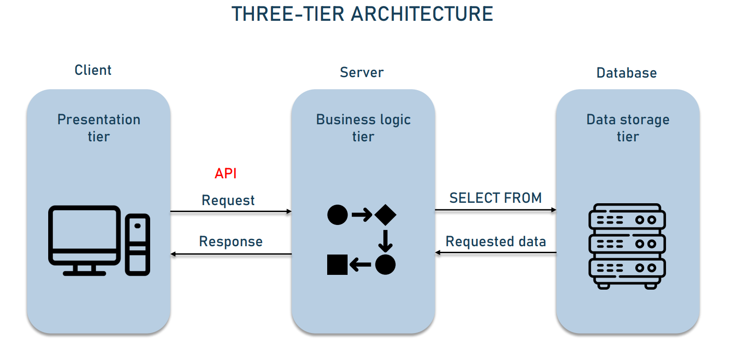
APIs in backend
API: Request response to backend
Business logic should be entirely in Server side
Presentation should be entirely in client side
JSON format, XML format, Swagger.
Monolith backend platform containing suite of APIs eg: node.js, PHP, .NET, Java etc.

Slide 6
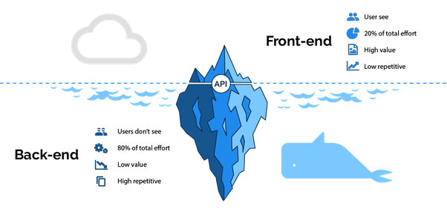
Backend focus
Majority of work is in backend
Performance is very critical
Updates to backend results in downtime
Monolithic architecture means cloud is always on
How to reduce downtime and reduce cloud usage?

Slide 7
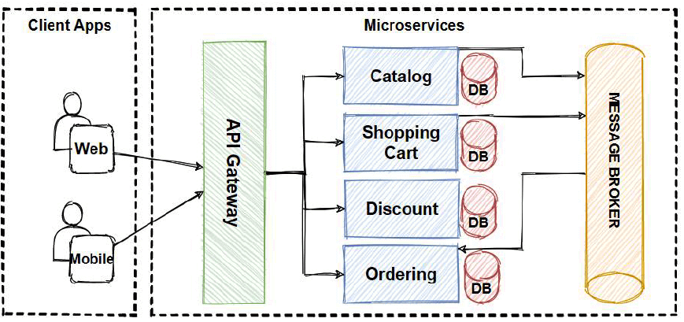
Microservices model
Splitting APIs into self sufficient containerized modules
Every API call intercepted by container of API which is waking up, processing and going to sleep.
Microservices can be updated independently resulting in low downtime
Microservices result in low cloud cpu usage

Slide 8
Mobile front end evolution
Front end and backend technologies
  Frontend: Android, iOS, Windows
  Backend: PHP, .NET, Java
Many builds being maintained for each frontend
Bugs arise due to updates in each flavour
Cross platform technology
  HTML5, Apache Cordova, Xamarin
  Single build generating multiple apps for different platforms.
  Support needed from community to be uptodate with each platform revision

Slide 9
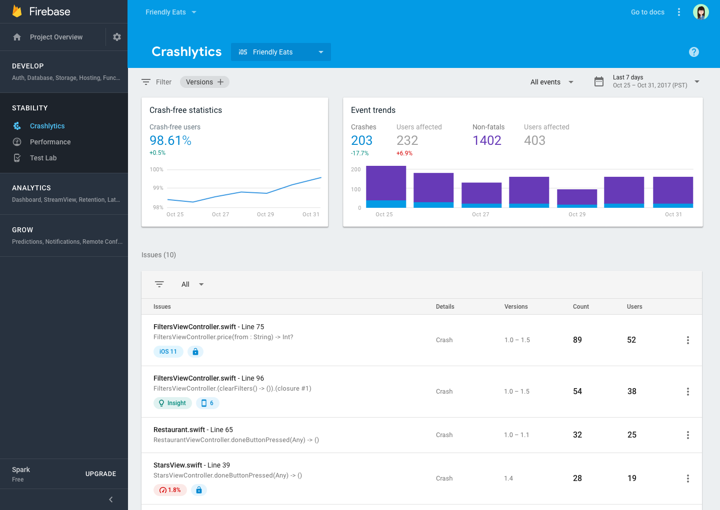
Performance and analytics
Usage and Crash Statistics
  Crashlytics, App dynamics
Decision making on performance improvement
Data analytics on user preference

Slide 10
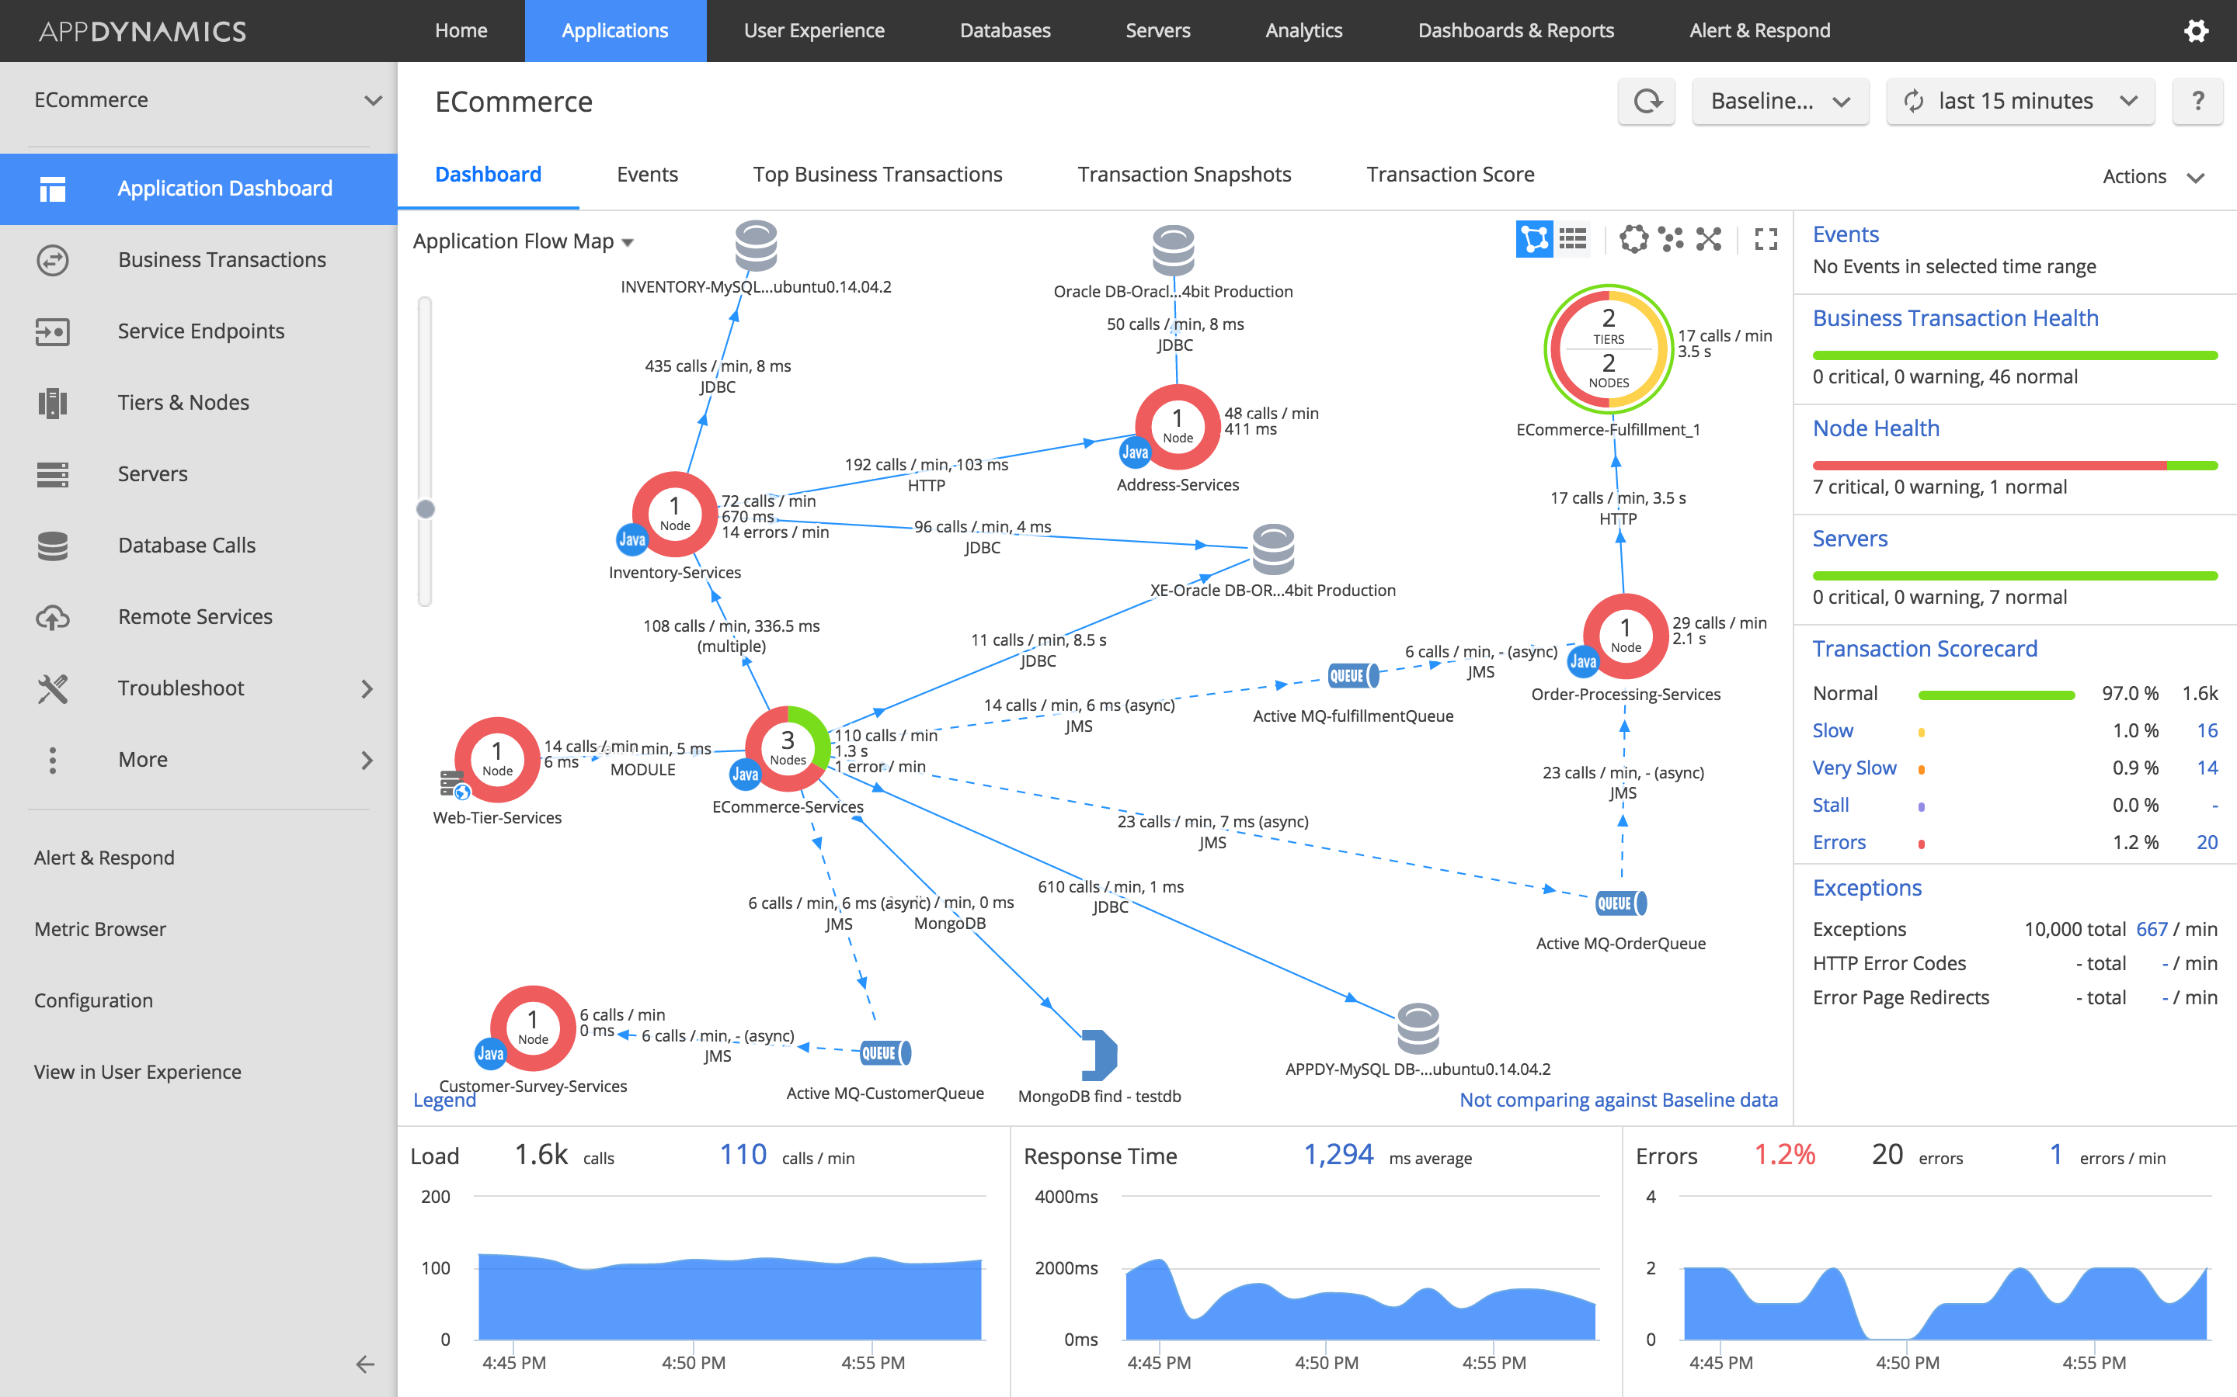

Slide 11
